Slide 1
E54 MH & COMPACTOR
24 JAN 2024

Slide 2
PRESENTATION FLOW
Step 1 – General Drawing with main assemblies
Step 2 – Drawing of focused assembly
Step 3 – Identify components of the focus assembly
Step 4 – Establish basic condition specifications
Step 5 – Determine applicable maintenance plan
Step 6 – Critical Spares
Step 7 – KSR’s

Slide 3
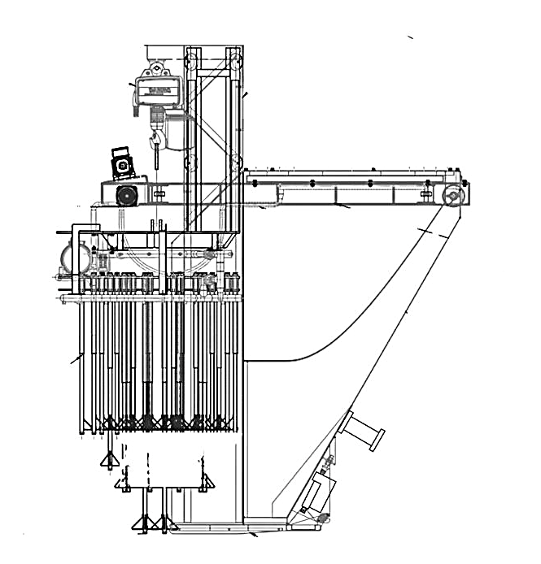
DRAWING
MOBILE HOPPER DRIVE ASSEMBLY
Geared Motor Assembly
Wheel Set
Guide Rollers
A
B
COMPACTOR ASSEMBLY
Vibrating Motor
Electric Hoist
Vibrating Tubes
Pre-Wetting Line
Vertical Guide Rollers
C
MOBILE HOPPER ASSEMBLY
Discharge Flap Cylinder
Knocking Device
Electrical Box
Hopper
Energy Chain Assembly

Slide 4
MOBILE HOPPER DRIVE ASSEMBLY
MOBILE HOPPER DRIVE ASSEMBLY
Geared Motor Assembly
1.1 Drive Motor
1.2 Gear Box
1.3 Drive Sprocket
1.4 Chain
1.5 Mounting Base
Wheel Set
2.1 Wheel Shaft
2.2 Driven Sprocket
2.3 Shaft Bearings
Guide Rollers
3.1 Roller Bearings
SIDE VIEW
1
2
2
3

Slide 5
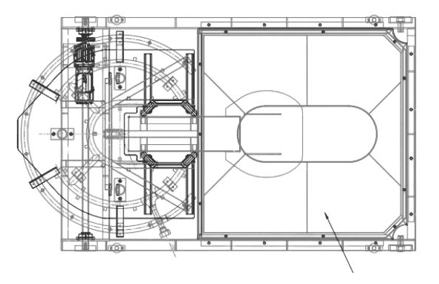
MOBILE HOPPER DRIVE ASSEMBLY
3
MOBILE HOPPER DRIVE ASSEMBLY
Geared Motor Assembly
1.1 Drive Motor
1.2 Gear Box
1.3 Drive Sprocket
1.4 Chain
1.5 Mounting Base
Wheel Set
2.1 Wheel Shaft
2.2 Driven Sprocket
2.3 Shaft Bearings
Guide Rollers
3.1 Roller Bearings
3
TOP VIEW
2
1
2
2
3
3

Slide 6
MOBILE HOPPER DRIVE ASSEMBLY
3
MOBILE HOPPER DRIVE ASSEMBLY
Geared Motor Assembly
1.1 Drive Motor
1.2 Gear Box
1.3 Drive Sprocket
1.4 Chain
1.5 Mounting Base
Wheel Set
2.1 Wheel Shaft
2.2 Driven Sprocket
2.3 Shaft Bearings
Guide Rollers
3.1 Roller Bearings
3
2
1
2
2
3
3

Slide 7
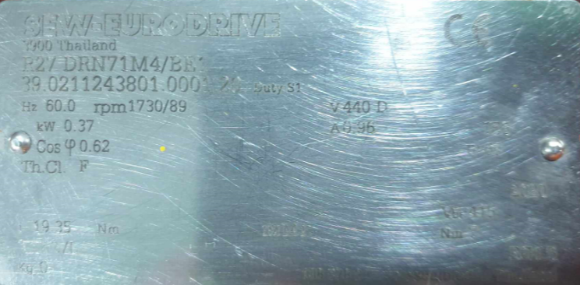
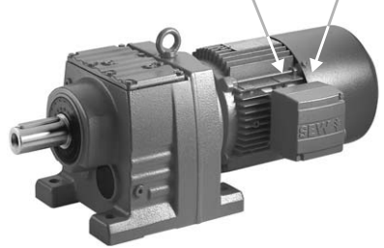
BASIC SPECS OF DRIVE MOTOR
Type designation gearmotor R27 DRNR1M4/BE1
Serial Number 39.0211243801.0001.20
Line frequency, Hz 60
Supply voltage, volt 440, 3-phase
Clamping connection Delta + GND
Speed ratio 1730/89
Motor power, kW 0.37
Power factor 0.62
Temperature class F
Max output torque, Nm 19.35
Full load current, Amp 0.96
Degree of protection IP65
Brake voltage, Volt 440, 1-phase
Braking torque, Nm 7
Brake control BG1.5
Inverter operation Duty S1 (continuous)
Mounting position M1 (foot-mounted)

Slide 8
1.1 BASIC CONDITION SPECS OF DRIVE MOTOR
COMPONENT | SPECIFICATIONS | UNIT | VALUE | Remarks
Winding | Resistance | Ohm | 33 | Measure only when motor CB is OFF
Winding | Insulation | Megaohm | > 10 | Measure only when motor CB is OFF
Winding | Full load current | Ampere | 0.96
Winding | Supply voltage | Volt | 440V | 3-phase
Terminal box | Clamping connection |  | Delta | With M4 nut and torque of 5Nm
DE Bearing | 6204 2Z-C3-K52 |  |  | Double sealed, no unusual sound
NDE Bearing | 6203 2Z-C3-K52 |  |  | Double sealed, no unusual sound
Motor frame | Temperature | °C | < 80 | Considering a reference ambient of 40°C
BG1.5 Brake module | Supply voltage | Volt | 440 | 1-phase
Drive Gear Sprocket | Number of Teeth | count | 12 | No signs of wear
Drive Gear Flange Bolt | M8x20 Hex head |  | 4 | Torque of 40Nm

Slide 9
1.2 BASIC CONDITION SPECS OF GEAR BOX
COMPONENT | SPECIFICATIONS | UNIT | VALUE | REMARKS
1.1Gear Box | RPM | RPM | 89 | Check running noise for possible bearing damage
 | Torque | Nm | 19.8
 | Power | Kw | 0.37
 | Lubricant type | Mineral Oil |  | Check oil level Visual check for leakage
Shaft assembly | diameter | in | 1
Key Bar | length | mm | 40
 | material | Carbon steel

Slide 10
1.3 – 1.4 BASIC CONDITION SPECS OF DRIVE SPROCKET & CHAIN
COMPONENT | SPECIFICATIONS | UNIT | VALUE | Remarks
Drive Gear Sprocket | Number of Teeth | count | 12 | No signs of wear & looseness
Chain Drive Duplex Chain | 60 Duplex Chain | number | 60-2 | Visual check of chain slackness
 | length | ft | 2.5 | Cut to fit
 | Material |  |  | Carbon Steel
 | Pitch | in | 0.75
 | Roller Width |  | 0.500
 | Roller Diameter |  | 0.469
 | Overall Width |  | 1.890
 | Plate Height |  | 0.712
 | Plate Thickness |  | 0.093
 | Pin Diameter |  | 0.234
 | Weight/ ft | lbs | 2.04
 | Ave Ultimate Strength | lbs | 18,530

Slide 11
1.5 BASIC CONDITION SPECS OF MOUNTING BASE
COMPONENT | SPECIFICATIONS | UNIT | VALUE | REMARKS
Base Plate Mounting | foot mounted type |  |  | Not loose & sprockets should be aligned using straight edge Fully supported by a jack bolt to prevent side-ways movement
Lock nuts & bolts | dimensions | mm | 8mm x 50mm
 | Torque tightness | Nm | 50 | 1) Match- marking should be aligned

Slide 12
1. MAINTENANCE PLANS
ACTIVITY | FREQUENCY | REMARKS
E54 MH Geared motor inspection | Every 2 weeks | Maintenance Plan 0910-030-358
E54 MH Geared motor lubrication | Every 52 weeks | Maintenance Plan 0910-030-352
E54 MH Drive motor winding and terminal tests | Every 52 weeks | For enrolment as PM03
E54 MH Drive motor bearing replacement | Every 104 weeks | For enrolment as PM03
E54 MH Drive motor brake assembly replacement | Every 104 weeks | For enrolment as PM03
E54 MH Drive motor thermal scan | Once per shift | Include in KSR of MWG
E54 MH Chain and sprocket Inspection | Every i-CIP | Include in KSR of AWG
E54 MH Geared motor assembly cleaning | Every i-CIP | Include in KSR of AWG
E54 MH Chain and sprocket lubrication | Every CIP | Include in KSR of AWG

Slide 13
CRITICAL SPARE PARTS LIST
EQUIPMENT | MANUFACTURER | SAFETY STOCK | REORDER POINT | P.O. NUMBER
Electric Hoist | Demag | 1 | 1 | 4554107473
Gear Motor | SEW R27 | 1 | 1 | -SAME-
Duplex Chain 60-2 (10ft) | KANA | 1 | 1 | -SAME-
Sprocket | Not specified | 1 | 1 | -SAME-
Proximity Sensors | IFM | 4 | 1 | -SAME-
Water Hose 1.2m & 18m | Alfagoma | 1 | 1 | -SAME-
Vibrating Motor | Venanzetti | 1 | 1 | -SAME-
Load cell Controller | Minebea | 1 | 1 | 3401315609

Slide 14
